Slide 1
H&M Personalized Fashion recommendations Product recommendations based on previous purchases
Team 11 | Barbara Call - Corine El Bitar - Madeleine Hayes
Notes:
Good morning everyone,
Today, we are excited to present to you a solution that our team has developed for H&M Group's product recommendation system. As you may know, H&M Group is a leading fashion retailer with an extensive online presence and a vast selection of products. However, with so many options available, customers may struggle to find what they are looking for, leading to a less-than-optimal shopping experience. This is why recommendation systems are key
Our team decided to tackle this challenge by developing a solution that leverages the power of machine learning using data from previous transactions, finding patterns in customer behavior to create personalized recommendations that guide customers towards products that are tailored to their preferences.

Slide 2
Overview
Data source : Kaggle
Data Type : jpg, csv images/ - a folder of images corresponding to each article_id; images are placed in subfolders starting with the first three digits of the article_id; note, not all article_id values have a corresponding image.
articles.csv - detailed metadata for each article_id available for purchase
customers.csv - metadata for each customer_id in dataset
transactions_train.csv - the training data, consisting of the purchases each customer for each date, as well as additional information. Duplicate rows correspond to multiple purchases of the same item. Your task is to predict the article_ids each customer will purchase during the 7-day period immediately after the training data period.
Notes:
The objective of this Kaggle competition is to predict what articles or items each customer will purchase in the 7-day period immediately after the training data ends. The data format ranges from .csv to jpeg type. We are given a folder of jpeg images for some of the articles but decided to exclude this from our approach. The rest of the data we are provided includes: a file containing article_ids and metadata, a file containing customer_ids and metadata, and transactions data from 2018-2020

Slide 3
THE DATA.
Notes:
So Lets take a closer look at the data

Slide 4
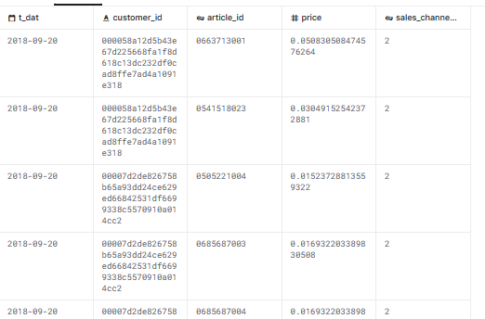
transactions.csv
Notes:
We are given the transaction history of customers from september 2018 to september 2020, this comes to a total of around 31 mil transactions, made by roughly 1 million customers, for 105k items., sales channel represents whether this was an online or in person transaction, with the majority being online so we excluded this from our approach
The data doesn’t include a transaction for every customer, or every item, but comes close. What happens when the model encounters a never seen before user or item? The competition states that Customers who did not make any purchases during the testing time frame are excluded from the scoring,but this is a very common issue when building recommendation systems, It is called the cold start problem. Since the majority of models generated would be based on the past user-item interactions, if a user has no history, then we can’t make a prediction. Although not implemented, In future iterations we agreed for our approach to be a base-average user to represent the average user profile based on all transactions, and for new items we decided we would compute the item to item similarity based on item meta data

Slide 5
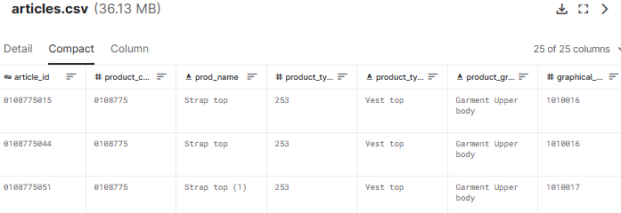
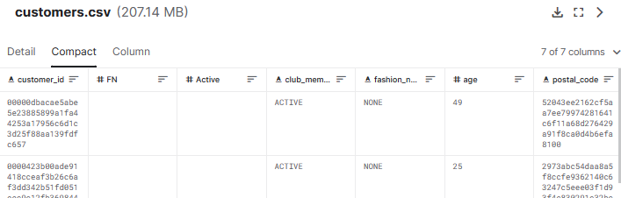
articles.csv and customers.csv
Notes:
We are also given information about several article_ids, with descriptive columns ranging from type to graphical appearance, and customer information ranging from age to fashion_news subscription, we considered some of these for ranking feature generation.
One last thing to note is the data we were provided with was not split into train/test data and the approach varied by submission. Now maddie will provide us a brief critique on one of the notebooks.

Slide 6
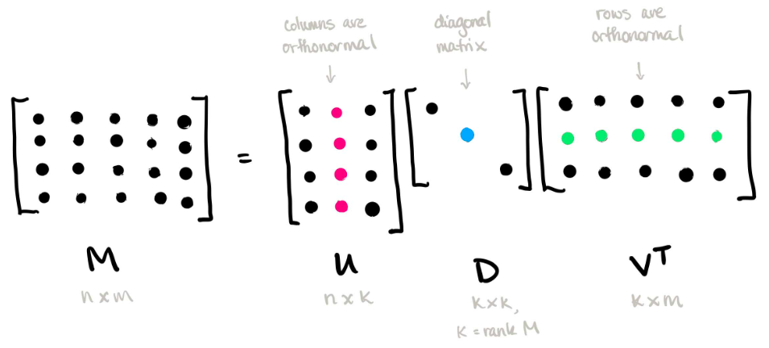
SVD
Notes:
Thank you Corine. So the notebook we decided to critique was a submission that approached recommendation with single value decomposition or SVD, which you may remember from the linear algebra bootcamp. SVD is a matrix factorization technique that reduces the number of features by reducing the space dimension. In the context of the recommender system, SVD is used as a collaborative filtering technique, using a matrix where each row represents a user, and each column represents an item. The elements of this matrix are the scores or ratings that are given to items by users.

Slide 7
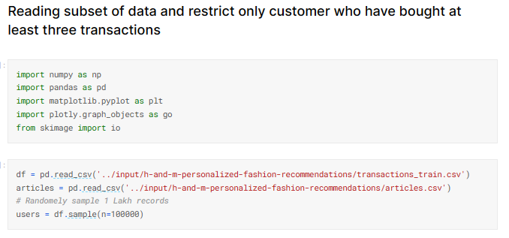
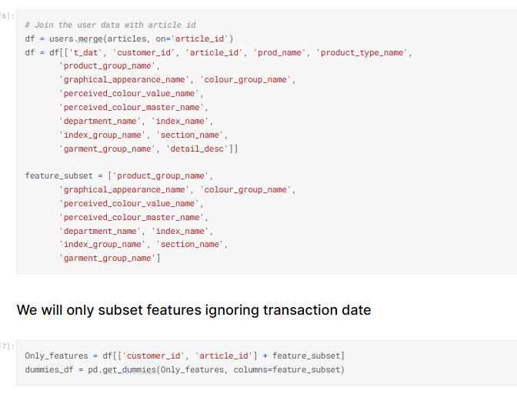
Critique
Joining on article id v
Random sampling ^
Notes:
The notebook begins by taking a random sample of customers transactions from the transaction data and using that for the SVD. The main issue with this is that it doesn’t take into account how recent the last customer interaction was. The transaction could be up to 2 years old which could mean the customer has since, decided to terminate its business with H&M, possibly due to poor customer experience for example. The recommendations based on that transaction could also be outdated. These randomly selected customer transactions are then joined with their corresponding clothing articles and the article metadata, and then transaction date is ignored.
Singular Value Decomposition for recommendation | Kaggle

Slide 8
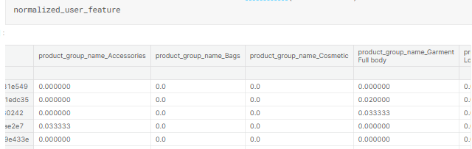
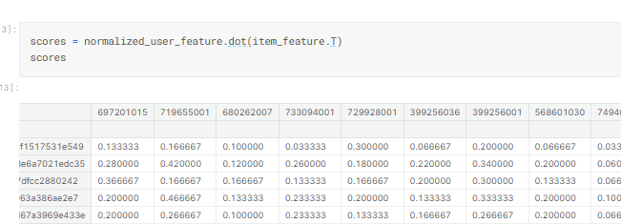
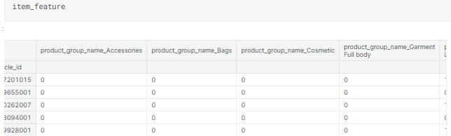
Normalized feature weights
3. scores
2. One hot encodings for features
Notes:
They then proceed to filter the sample by customers who made at least 3 transactions. They created a feature weights matrix, normalized it, and also generated a matching one-hot-encodings matrix with one-hot encodings for each article feature category. They generated scores for each user-item interaction using the dot product which created a scores matrix, with each row as a customer and each column representing an item which gives the user-item matrix. Next they took the SVD. Through a series of function calls, the SVD is used to generate similar items to ones purchased using cosine similarity and the top 10 recommendations are returned. Again, these recommendations are limited to the sample of transactions the author selected which was random and not representative of currently trending H&M Articles. Now Barbara will go through our solution
H&M EDA FIRST LOOK | Kaggle

Slide 9
THE CODE.
Notes:
So Lets take a closer look at the data

